Slide 1
Latent-heating impact on tides in Middle and Upper Atmosphere Model MUAM

Slide 2
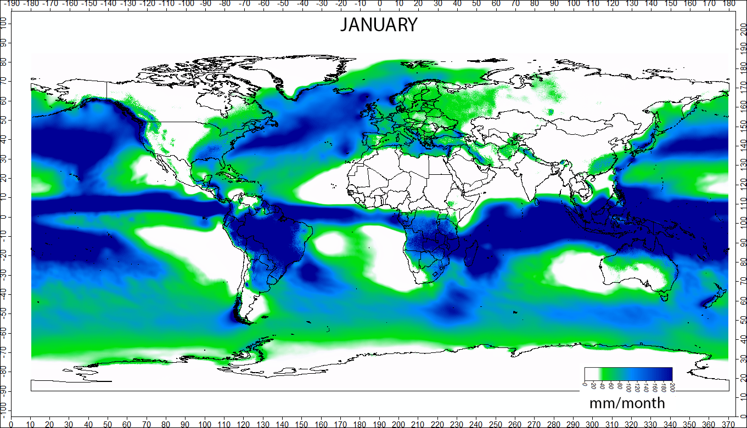
Contents
Motivation & State of knowledge
Basics
Latent heat
Tides
ENSO
MUAM
Comparison with/without LH
Summary
Long-term mean precipitation by month, en.wikipedia.org

Slide 3
Motivation & State of knowledge
DT (SDT) are excited mainly by absorption of water vapor (ozon) in the troposphere (stratosphere)
Latent heat:
Forces nonmigrating tidal modes which propagate into upper atmosphere (Williams & Avery 1996)
Forcing mechanism for tides (Forbes et al. 1997, Zhang et al. 2006)
Variations most apparent at 80 and 150 km height with amplitude variations of 10 - 20 m/s and 5 - 15 K for DT/SDT (Hagan et al. 2002)
Nonmigrating components can vary (Hagan et al. 2002)
Solar heating and latent heat release contributions are comparable in production of atmospheric tides (Williams & Avery 1996)
Variation of latent heat has a significant effect on tides (Hamilton 1981, Williams & Avery 1996, Forbes et al. 1997, Hagan et al. 2002)
Notes:
Lat heat not evenly distributed -> non-migrating

Slide 4
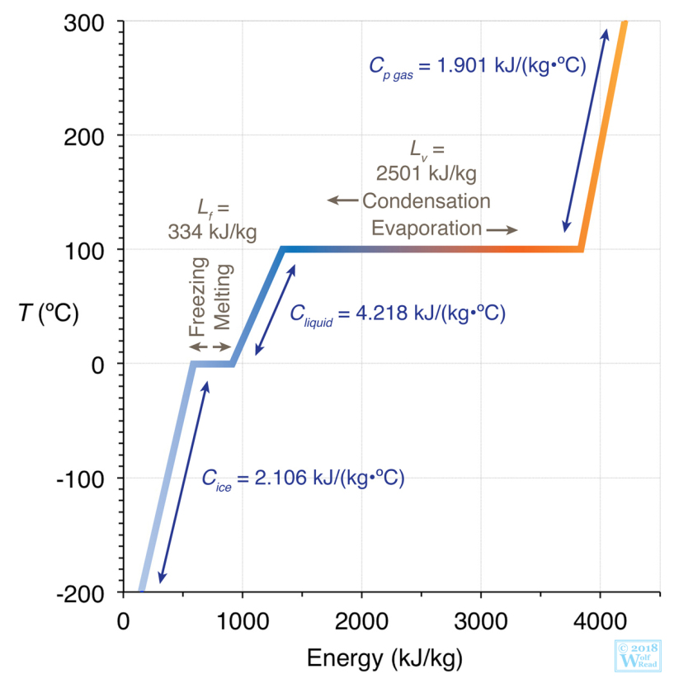
Basics: Latent heat
Heat of transformation consumed or released during the change of aggregate states
Heat of evaporation/condensation (liquid ↔ gas)
Heat of melting/freezing (solid ↔ liquid)
Heat of deposition/sublimation (gas ↔ solid)
Stull, 2017

Slide 5
Basics: Latent heat
Convective precipitation (in clouds under deep convection) is prevailing source of humidity in the tropical and subtropical troposphere
→ Water vapor condensation/evaporation
→ Main source of latent heat

Slide 6
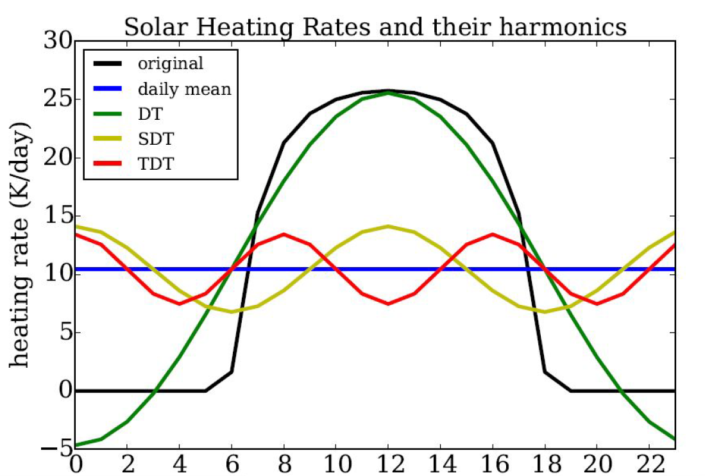
Solar atmospheric tides
Fourier analysis of black curve gives harmonic oscillations with periods of 24 h (DT), 12 h (SDT), 8 h (TDT), 6 h (QDT, not shown)
For 2.5° north in 50 km height from Lilienthal, 2019

Slide 7
Basics: Atmospheric tides
Important mechanism for transporting energy from the lower atmosphere into the upper atmosphere
Density varies significantly with height → kinetic energy must be conserved → increasing amplitudes with height
Atmospheric tides excited by:
Solar heating
(Gravity by moon/sun)
Non-linear interactions between tides/planetary waves
Latent heat

Slide 8
Solar atmospheric tides
= Thermal tides by solar heating
Migrating tides:
Propagate sun synchronous, westwards with the apparent motion of the sun
Non-migrating tides:
Do not propagate sun synchronous
do not propagate horizontally
propagate eastwards
propagate westwards at a different speed to the sun
Generation:
differences in topography
land-sea contrast
surface interactions

Slide 9
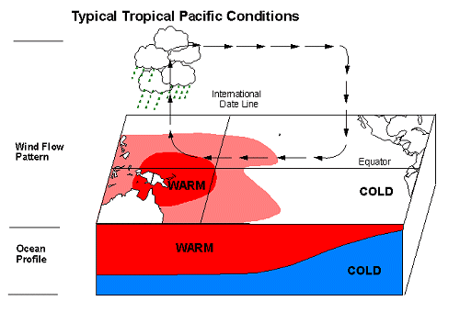
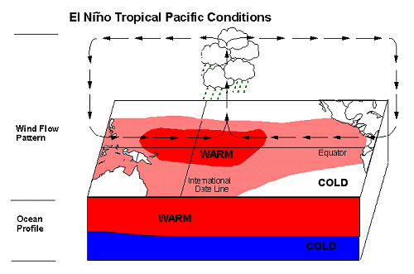
El Niño/La Niña-Southern Oscillation ENSO
Self-reinforcing warm/cold phase by anomalies of Walker circulation every 4 years
www.elnino.info

Slide 10
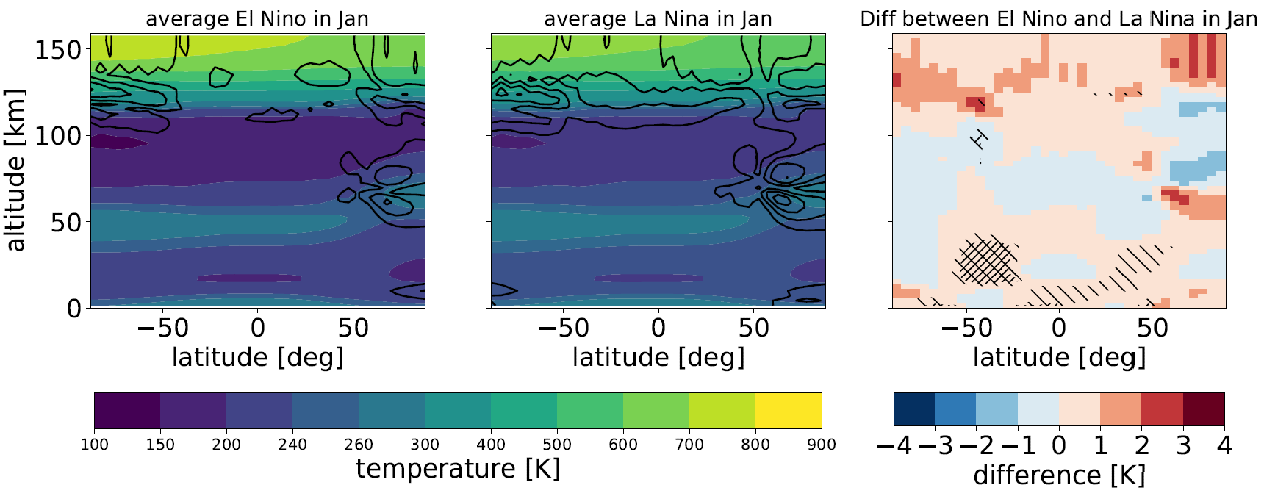
El Niño/La Niña - Temperature
Without LH, Stober, 2020

Slide 11
Impacts of ENSO
Wind (pressure gradients)
Precipitation
Temperature (air and water)
→ Global impacts by atmospheric teleconnections (planetary waves)

Slide 12
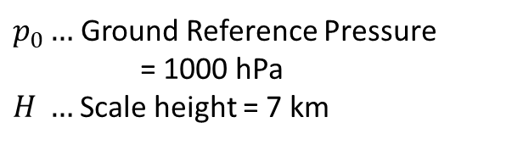
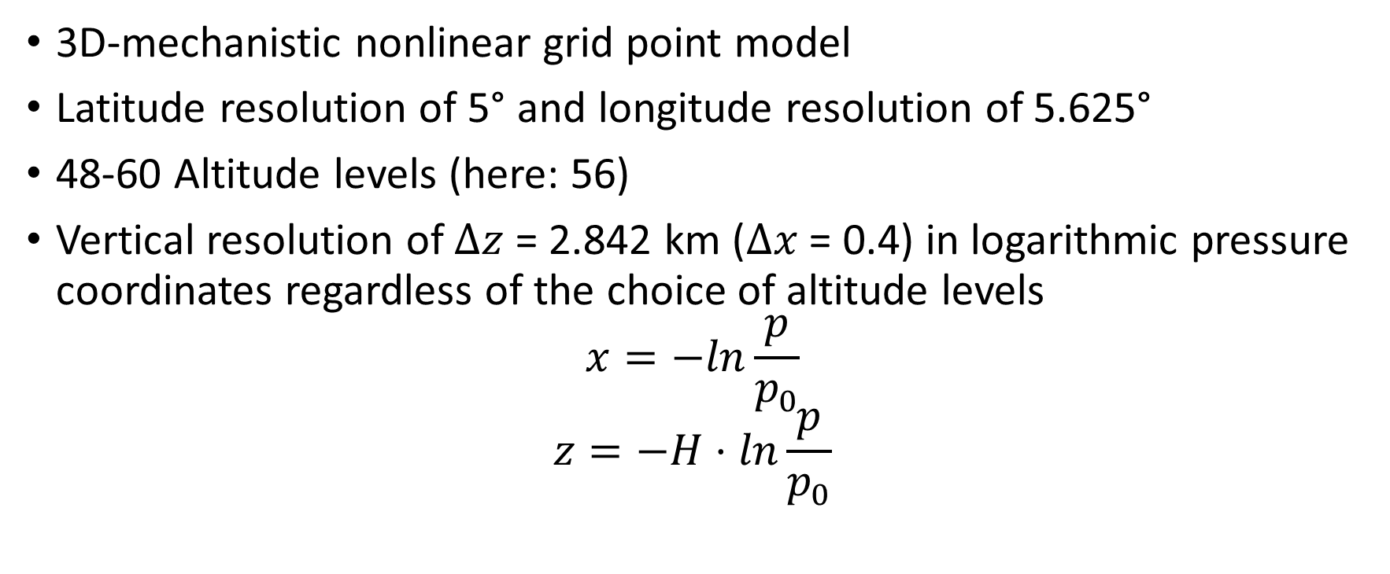
Middle and Upper Atmosphere Model MUAM
3D-mechanistic nonlinear grid point model
Latitude resolution of 5° and longitude resolution of 5.625°
48-60 Altitude levels (here: 56)
Vertical resolution of $Δz$ = 2.842 km ($Δx$ = 0.4) in logarithmic pressure coordinates regardless of the choice of altitude levels
$$x=−ln\frac{p}{p_{0}}$$
$$z=−H⋅ln\frac{p}{p_{0}}$$
$p_{0}…$Ground Reference Pressure
= 1000 hPa
$H …$Scale height = 7 km

Slide 13
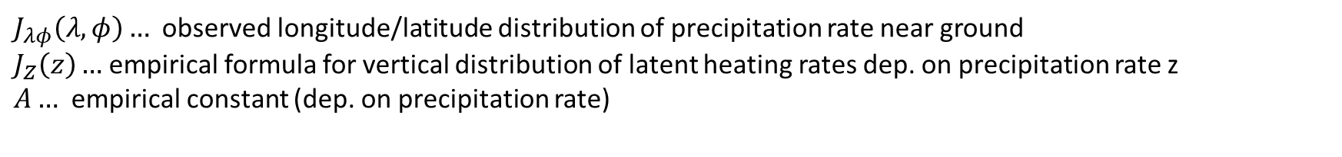
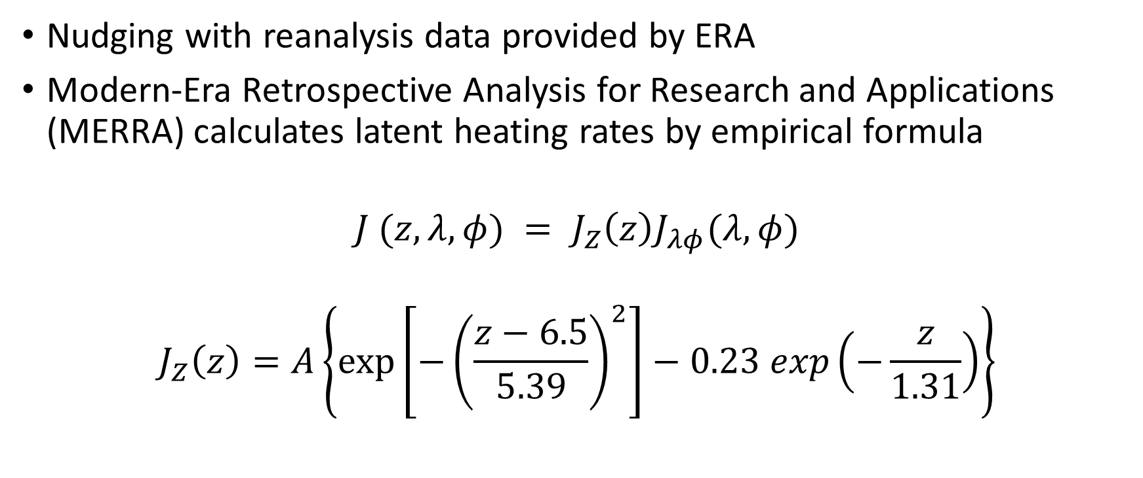
MUAM: Data and Analyzing
Nudging with reanalysis data provided by ERA
Modern-Era Retrospective Analysis for Research and Applications (MERRA) calculates latent heating rates by empirical formula
$$J (z, λ, φ) = J_{Z}\left(z\right)J_{λφ}(λ, φ)$$
$$J_{Z}\left(z\right)=A\left\{\exp\left[−{\left(\frac{z−6.5}{5.39}\right)}^{2}\right]−0.23 exp\left(−\frac{z}{1.31}\right)\right\}$$
$J_{λφ}\left(λ, φ\right)…$ observed longitude/latitude distribution of precipitation rate near ground
$J_{Z}\left(z\right)…$ empirical formula for vertical distribution of latent heating rates dep. on precipitation rate z
$A…$ empirical constant (dep. on precipitation rate)

Slide 14
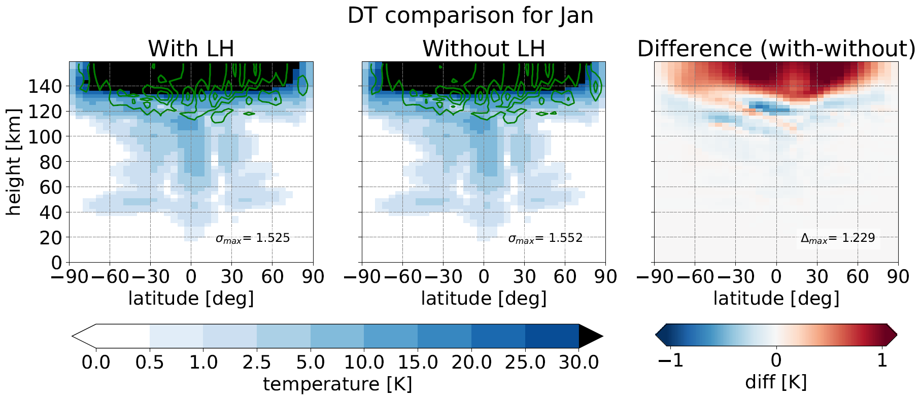
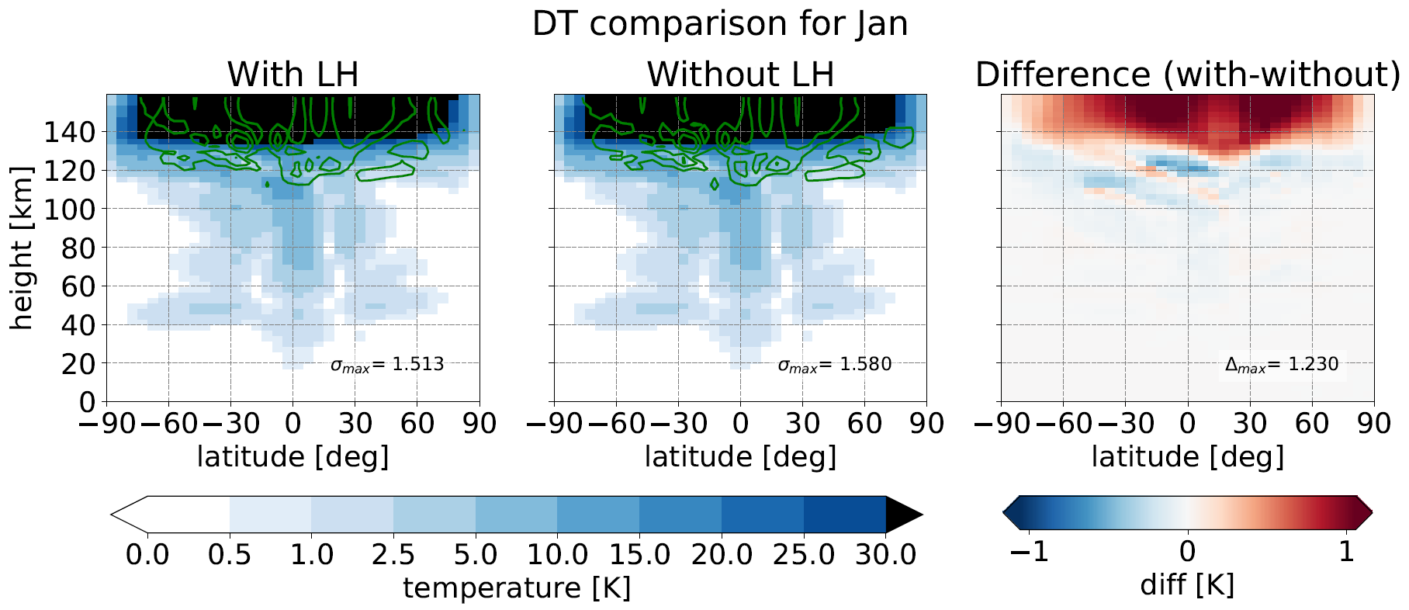
Results: Temperature: El Niño La Niña
DT
SDT
TDT
QDT

Slide 15
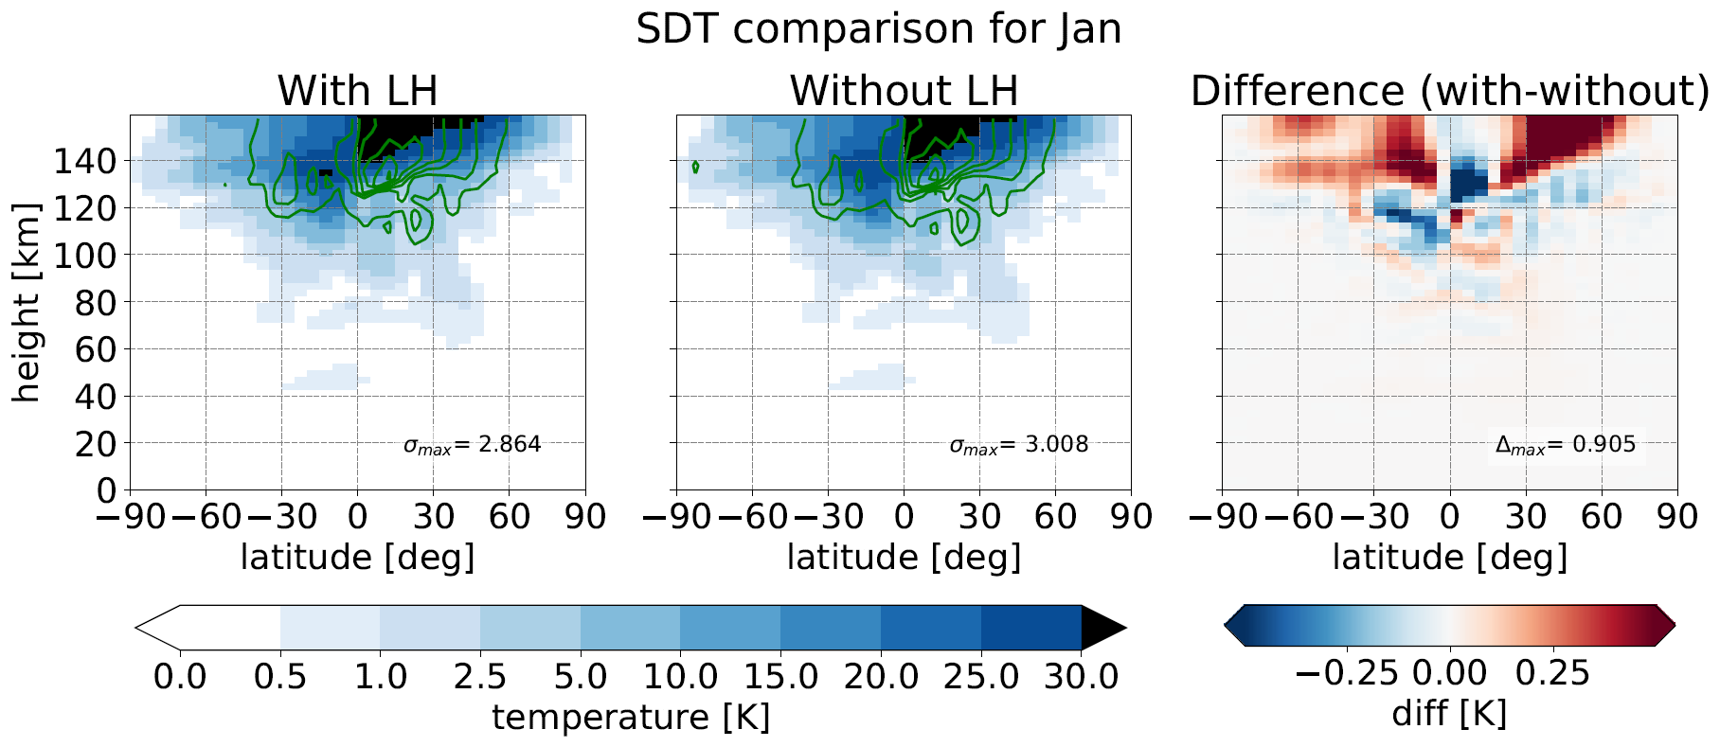
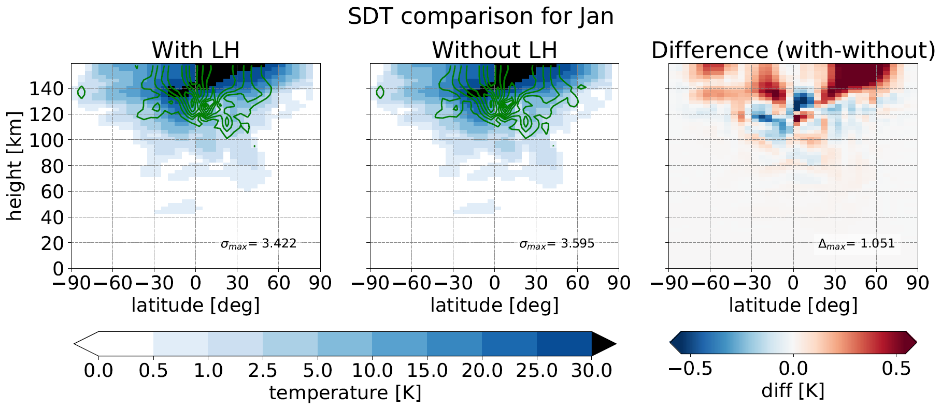
Temperature: El Niño La Niña
DT
SDT
TDT
QDT

Slide 16
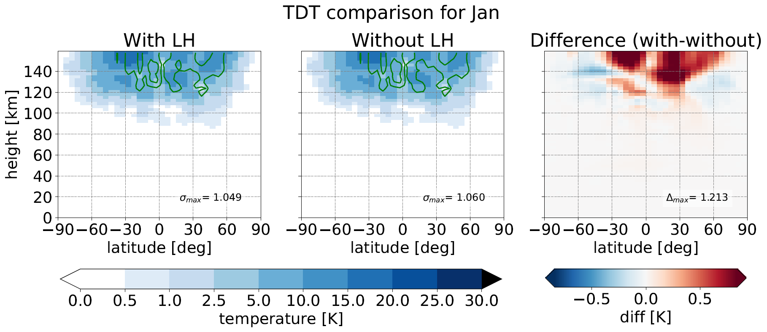
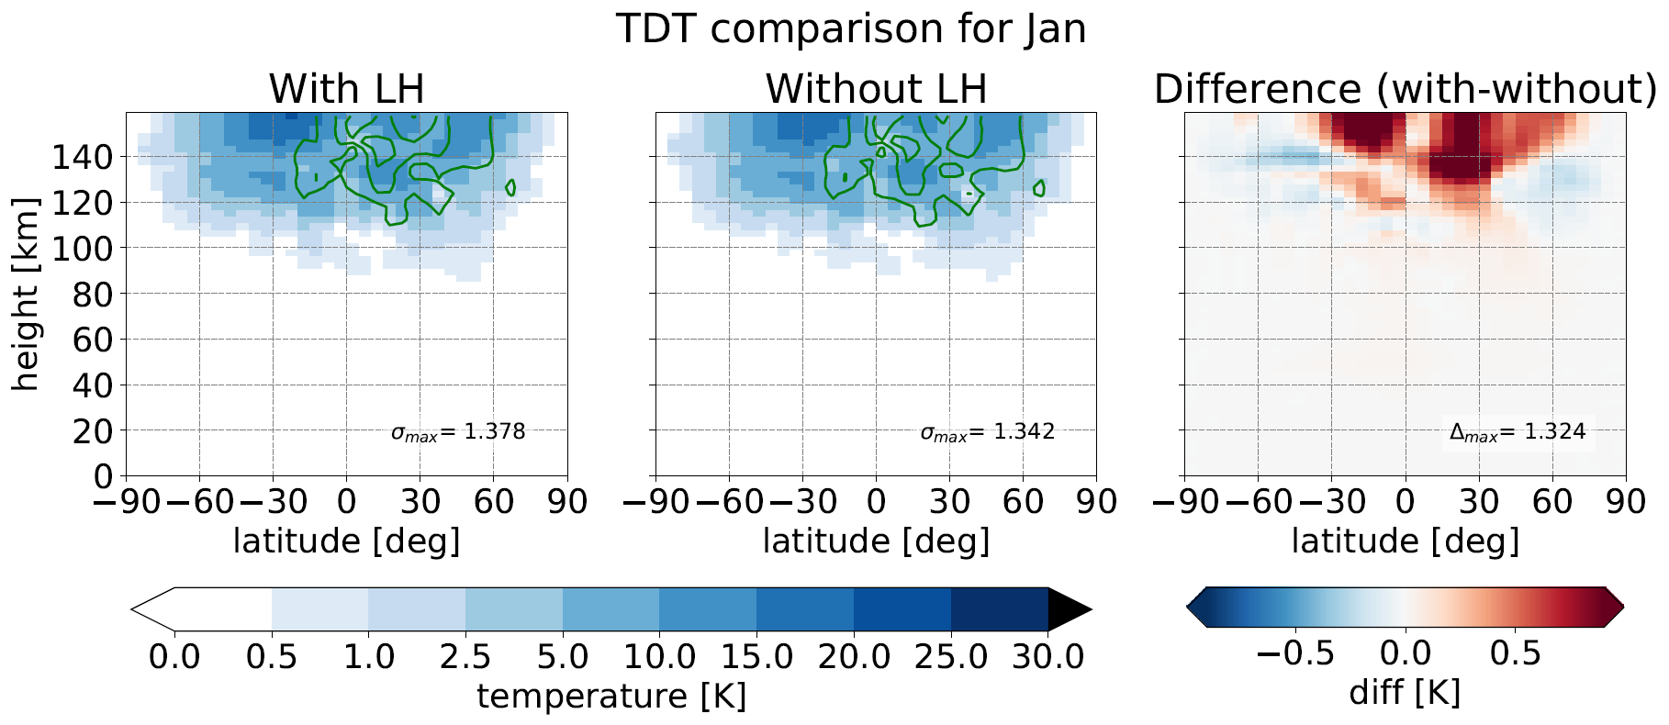
Temperature: El Niño La Niña
DT
SDT
TDT
QDT

Slide 17
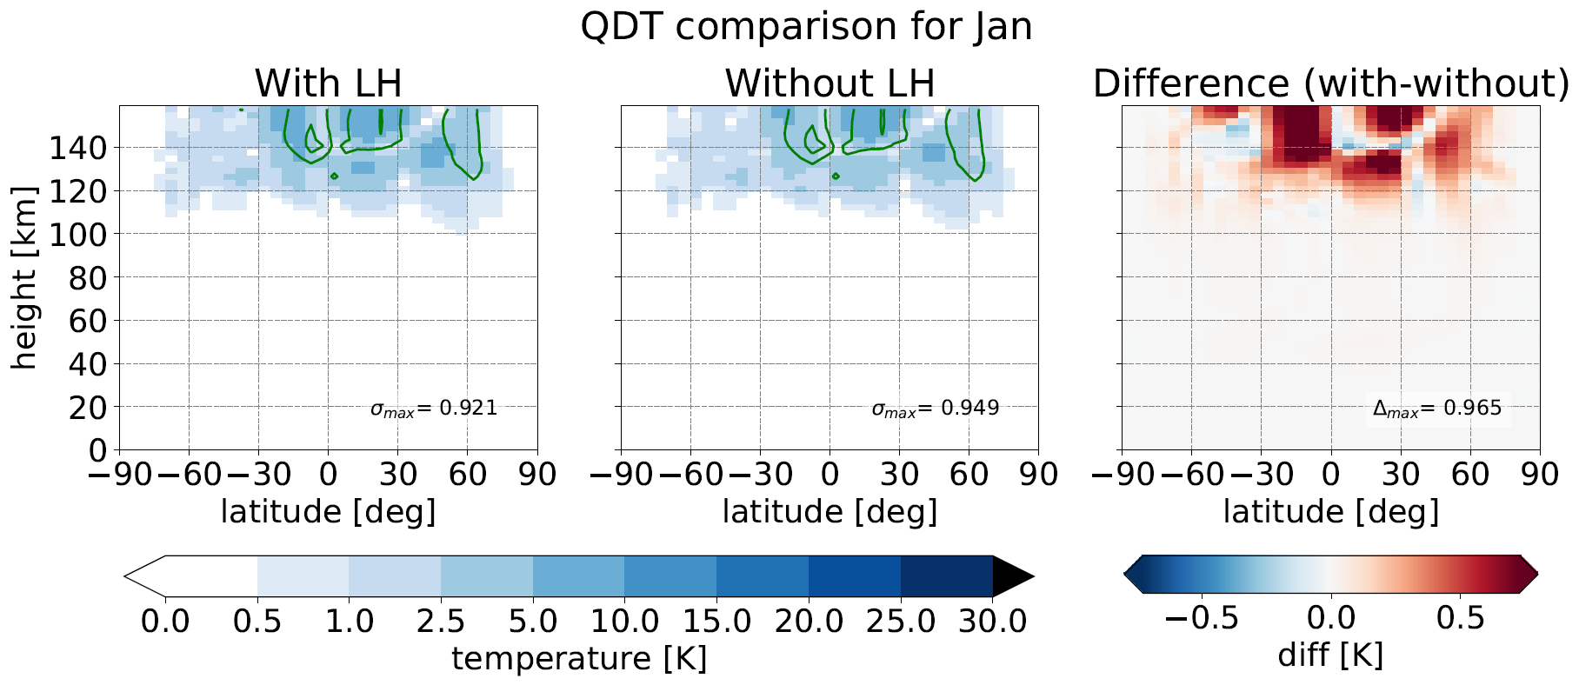
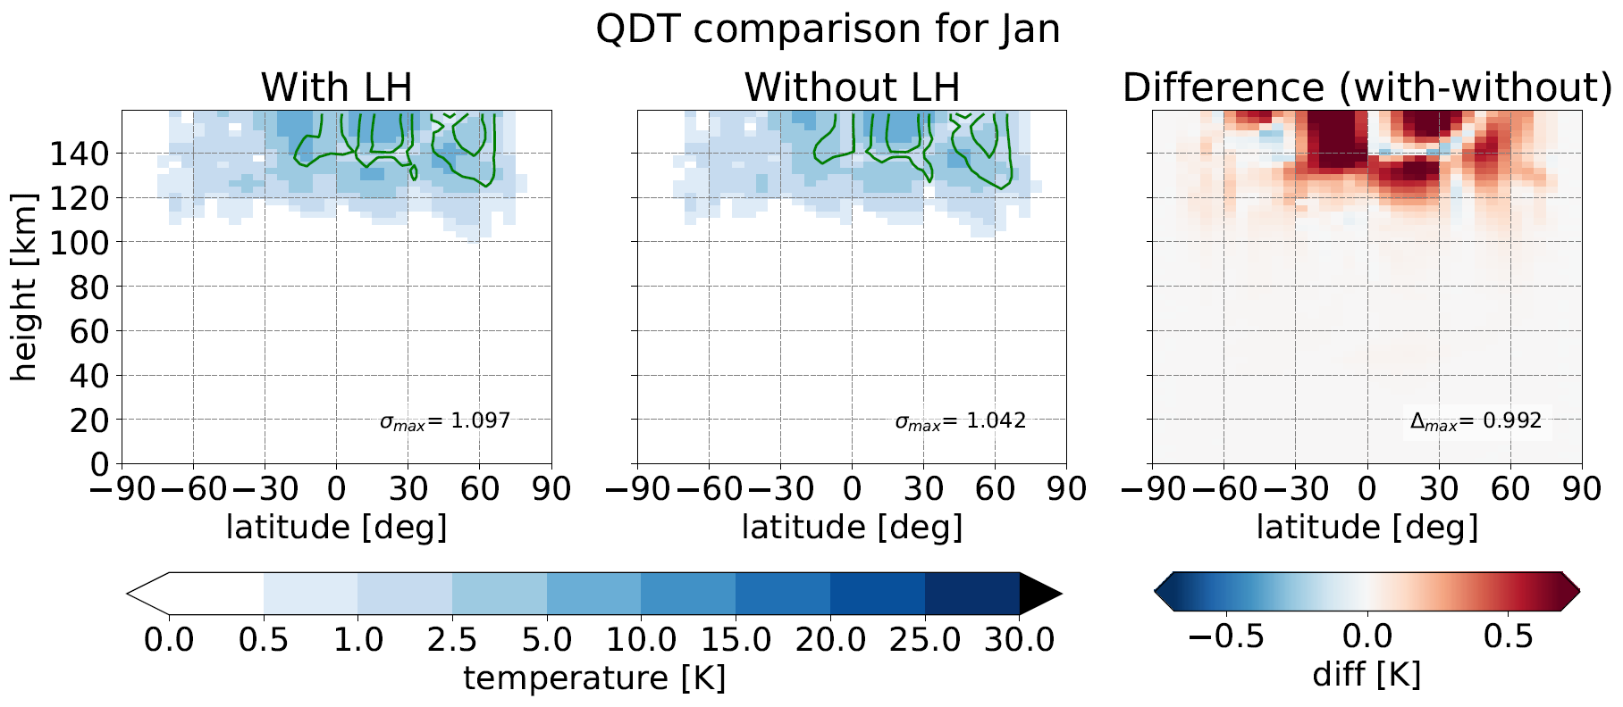
Temperature: El Niño La Niña
DT
SDT
TDT
QDT

Slide 18
Temperature comparison
Variations of 5 - 15 K for DT/SDT (Hagan et al. 2002) ?

Slide 19
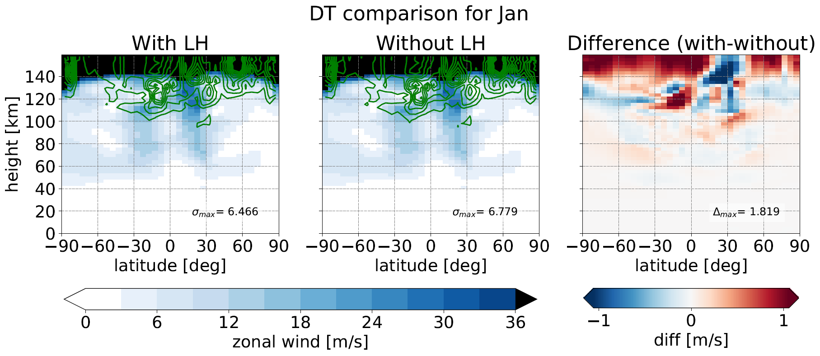
Zonal wind: EL
DT
SDT
TDT
QDT

Slide 20
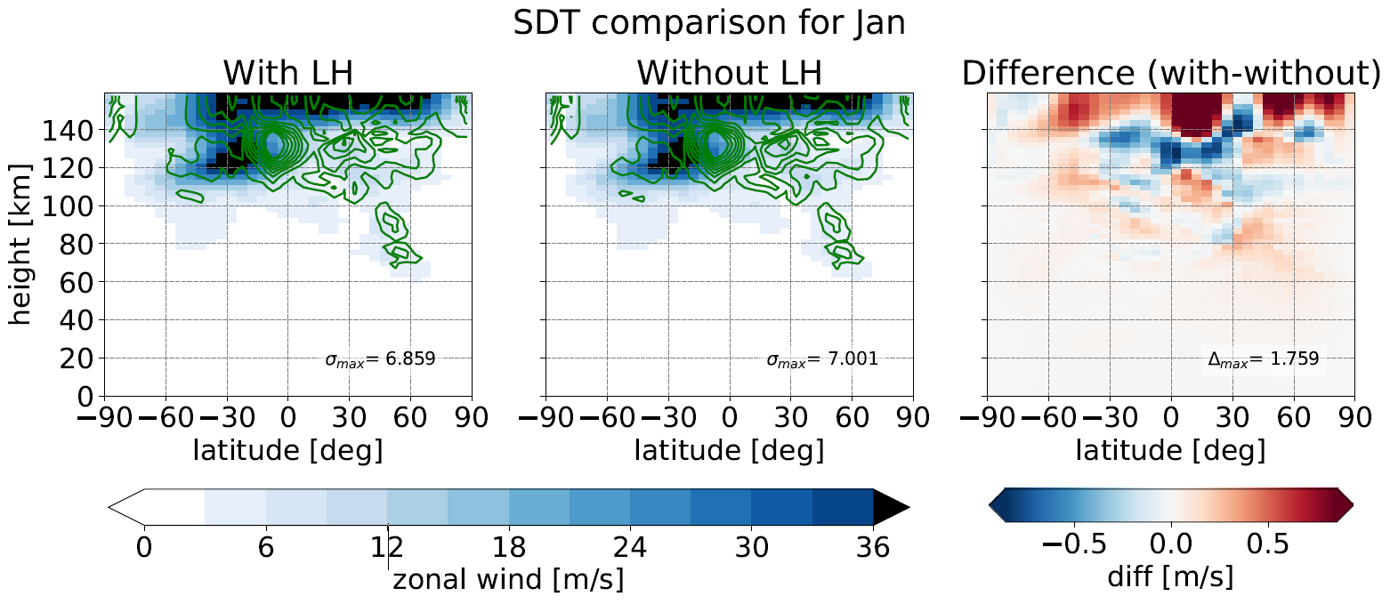
Zonal wind: EL
DT
SDT
TDT
QDT

Slide 21
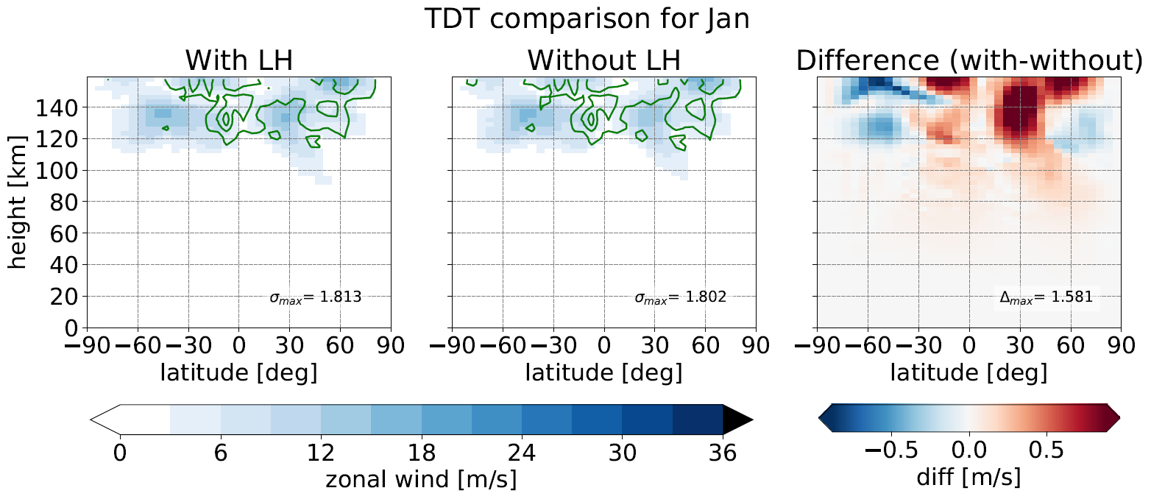
Zonal wind: EL
DT
SDT
TDT
QDT

Slide 22
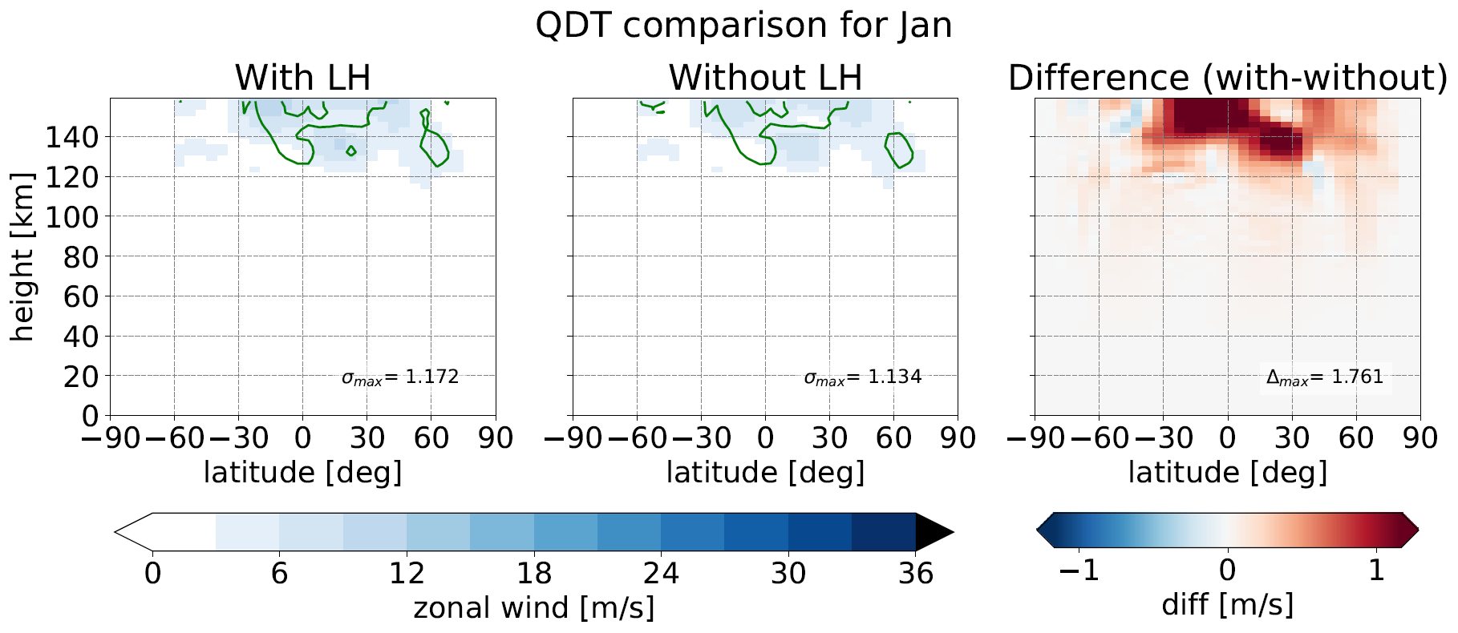
Zonal wind: EL
DT
SDT
TDT
QDT

Slide 23
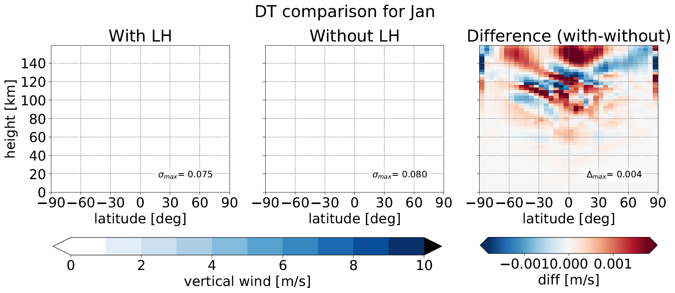
Vertical wind: EL
DT
SDT
TDT
QDT

Slide 24
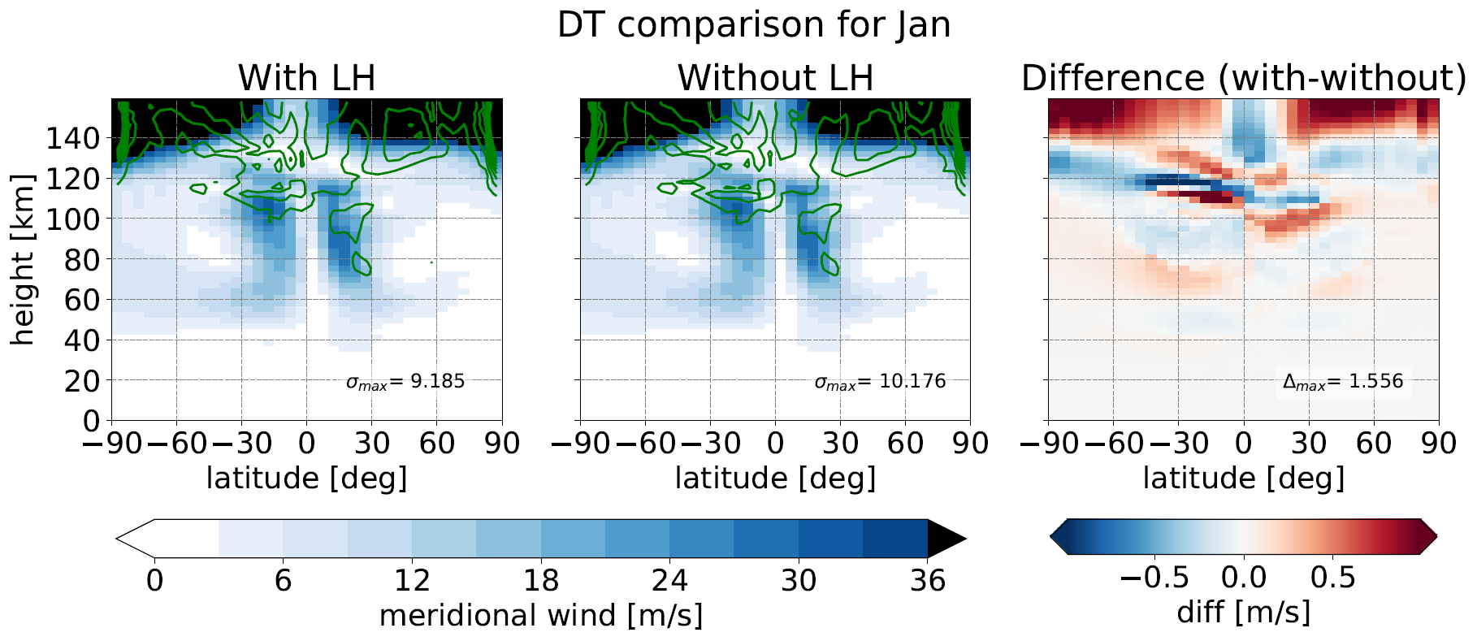
Meridional wind: EL
DT
SDT
TDT
QDT

Slide 25
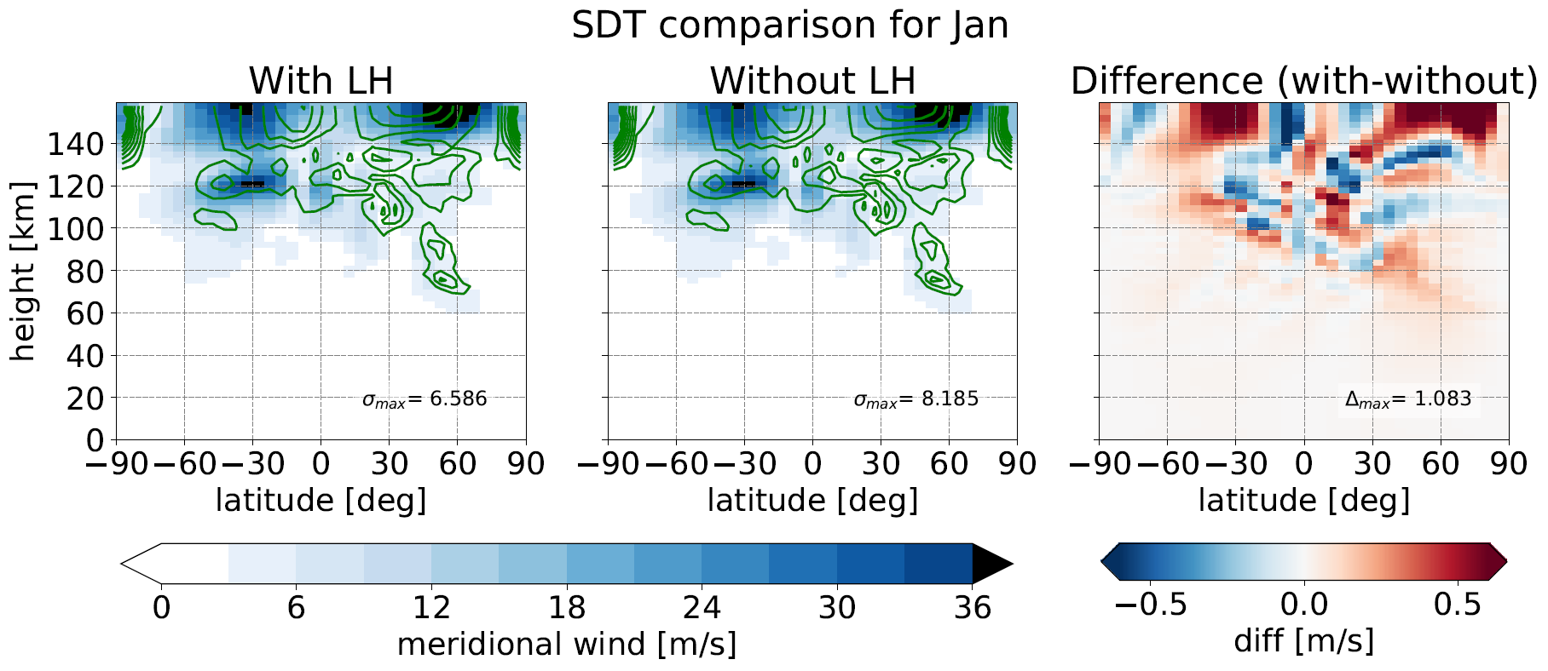
Meridional wind: EL
DT
SDT
TDT
QDT

Slide 26
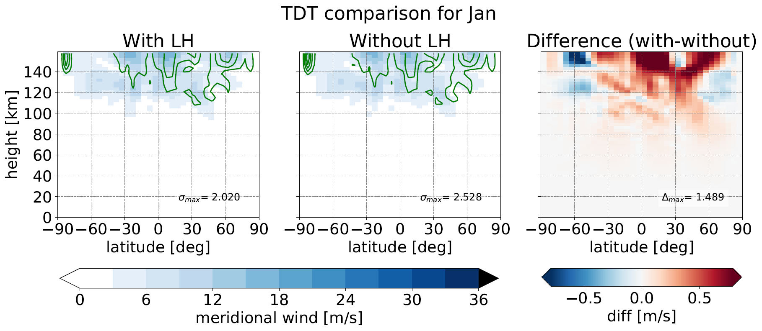
Meridional wind: EL
DT
SDT
TDT
QDT

Slide 27
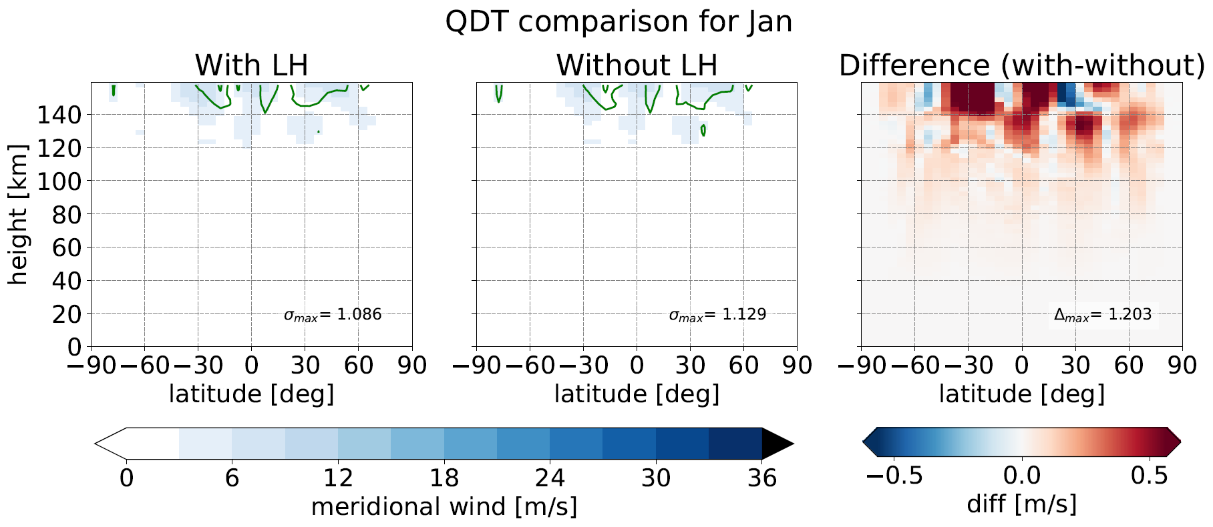
Meridional wind: EL
DT
SDT
TDT
QDT

Slide 28
Wind comparison
Variations of 10 - 20 m/s for DT/SDT (Hagan et al. 2002) ?

Slide 29
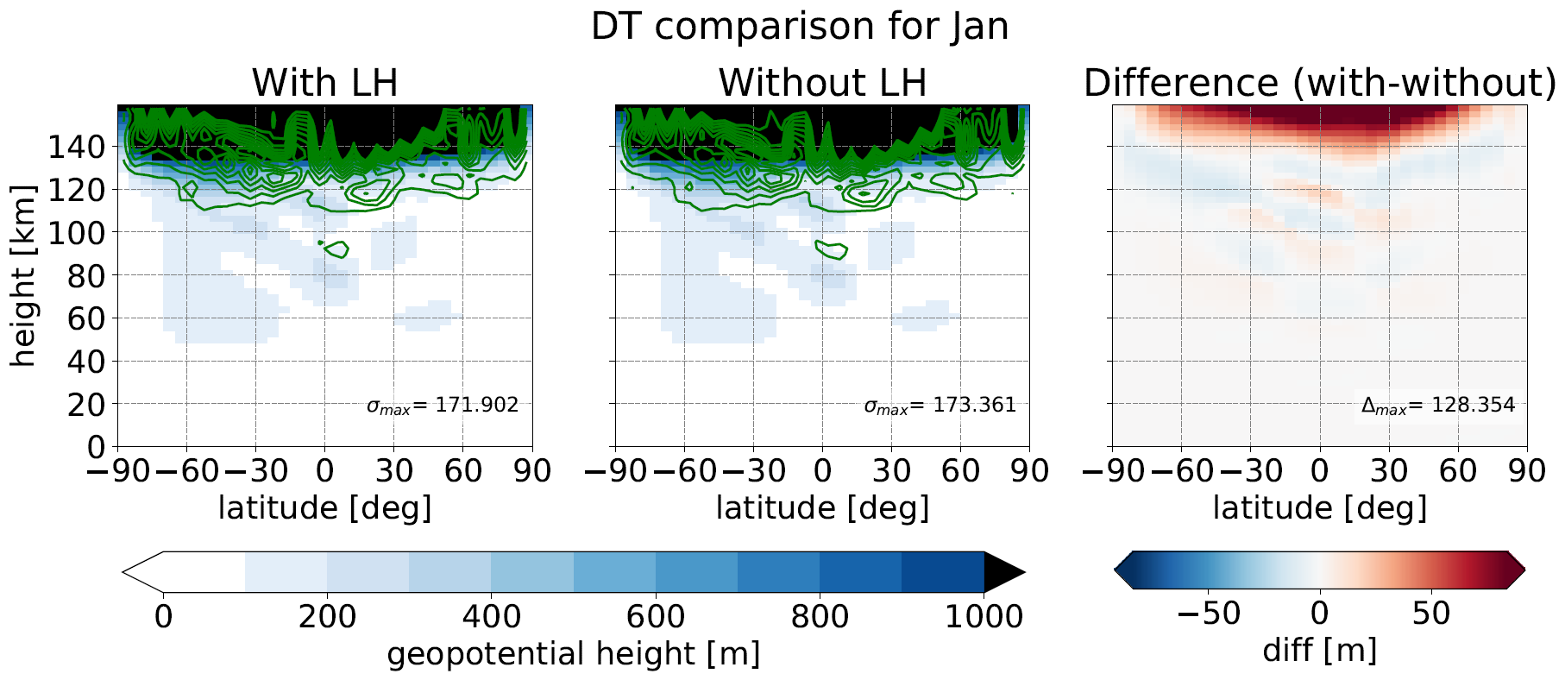
Geopotential height: EL
DT
SDT
TDT
QDT

Slide 30
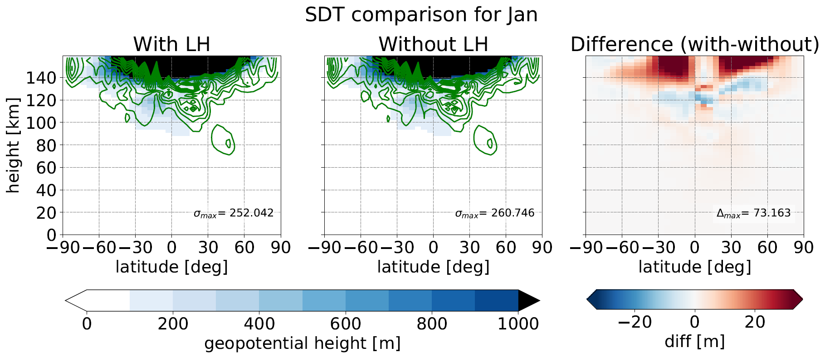
Geopotential height: EL
DT
SDT
TDT
QDT

Slide 31
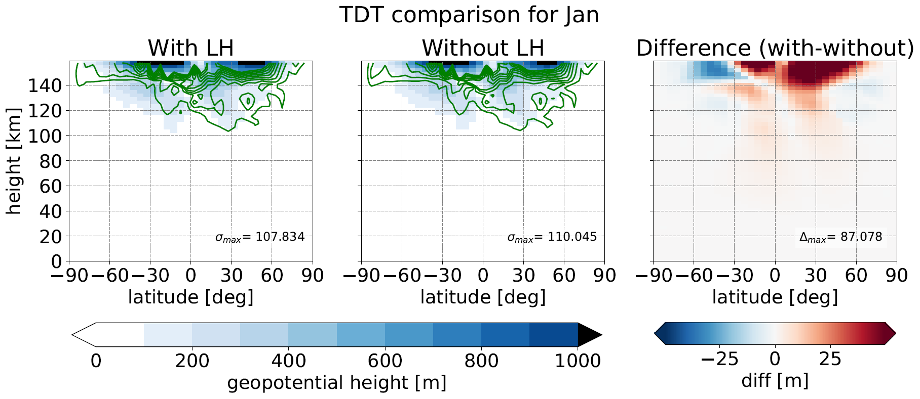
Geopotential height: EL
DT
SDT
TDT
QDT

Slide 32
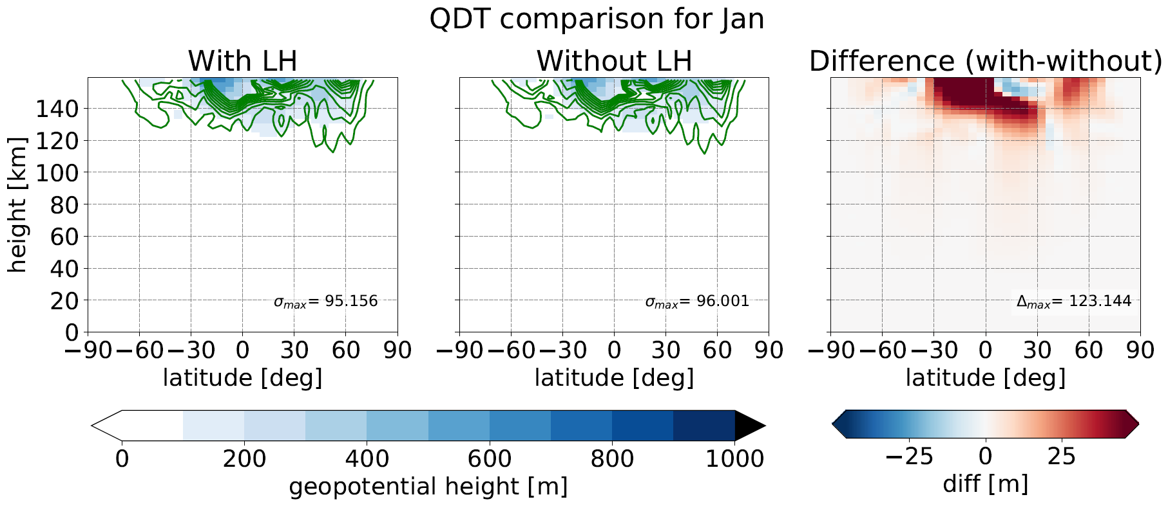
Geopotential height: EL
DT
SDT
TDT
QDT

Slide 33
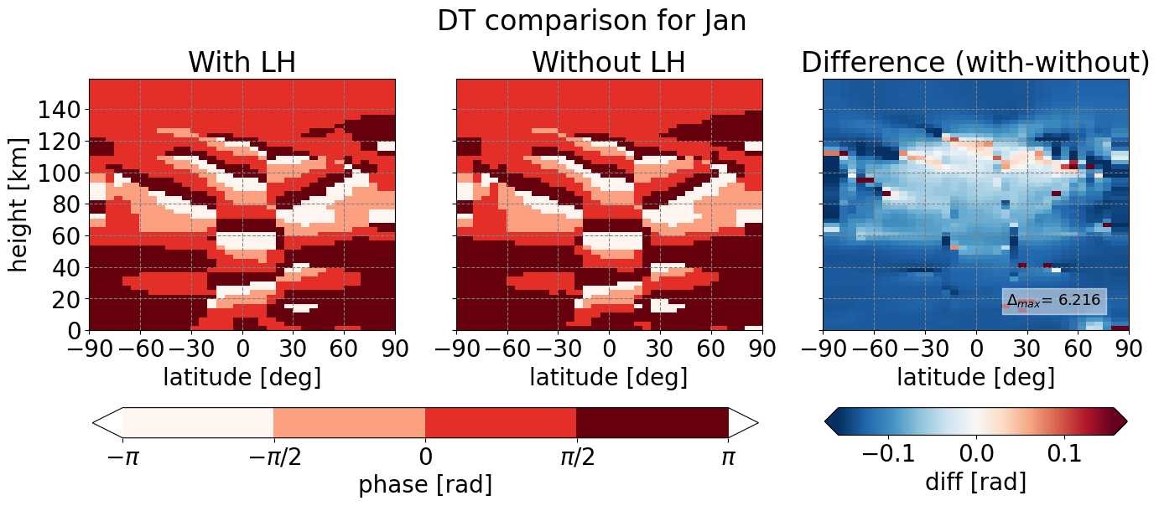

Phase of Temperature: El Niño La Niña
DT
SDT
TDT
QDT

Slide 34
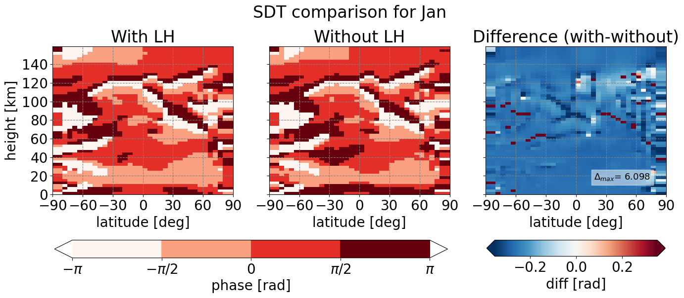
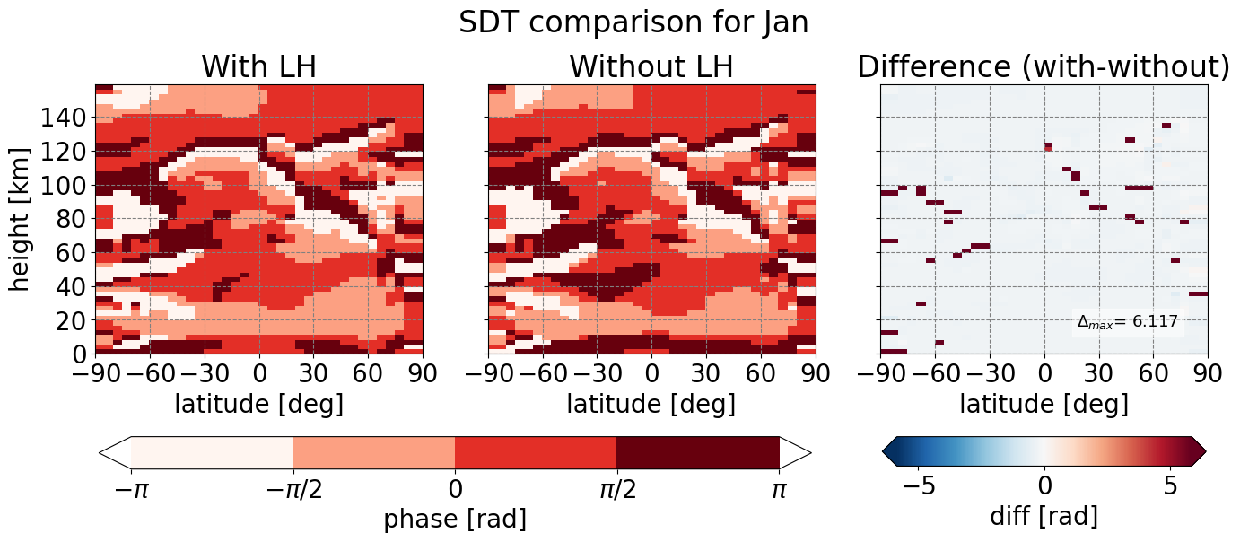
Phase of Temperature: El Niño La Niña
DT
SDT
TDT
QDT

Slide 35
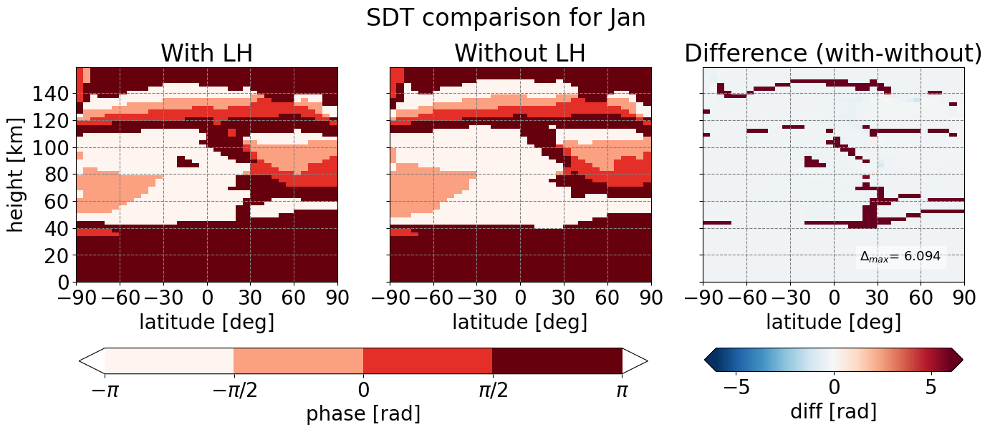
Phase of zonal wind: EL
DT
SDT
TDT
QDT

Slide 36
Effect of LH on tides?
, but small effect
Yes
Variations most apparent at 80 and 150 km height with amplitude variations of 10 - 20 m/s and 5 - 15 K for DT/SDT (Hagan et al. 2002)
Notes:
Hagan: Five additional nonmigrating diurnal components

Slide 37
Summary
Amplitudes become smaller with smaller period of tide
Latent heat increases values of amplitude of tides overall
Small effect in MUAM
Biggest differences alternate between DT/SDT/TDT/QDT
Negletable phase changes
Tides remain, but with slighty higher amplitudes

Slide 38
References
El Nino Infoseite zur Klimaanomalie im Pazifik, http://www.elnino.info/k1.php, Kapitel 1, Zugriff: 28.01.2021
Forbes, J. M., Hagan, M. E., Zhang, X., & Hamilton, K. (1997, October). Upper atmosphere tidal oscillations due to latent heat release in the tropical troposphere. In Annales Geophysicae (Vol. 15, No. 9, pp. 1165-1175). Springer-Verlag.
Gurubaran, S. Understanding Atmospheric Tides: Challenges to Middle Atmospheric Dynamicists.
Hagan, M. E., & Forbes, J. M. (2002). Migrating and nonmigrating diurnal tides in the middle and upper atmosphere excited by tropospheric latent heat release. Journal of Geophysical Research: Atmospheres, 107(D24), ACL-6.
Hagan, M. E., & Forbes, J. M. (2003). Migrating and nonmigrating semidiurnal tides in the upper atmosphere excited by tropospheric latent heat release. Journal of Geophysical Research: Space Physics, 108(A2).
Hamilton, K. (1981): “Latent heat release as a possible forcing mechanism for atmospheric tides”-volume 109. Monthly Weather Review. pages 3 – 17.
Lilienthal, F.: Analysis of the Forcing Mechanisms of the Terdiurnal Solar Tide in the Middle Atmosphere, Dissertation, Universität Leipzig, 167, 2019.
Long-term mean precipitation by month gif, https://en.wikipedia.org/wiki/Precipitation, Zugriff: 28.01.2021
Stull, R. (2017): “Practical Meteorology: An Algebra-based Survey of Atmospheric Science” -version 1.02b. University of British Columbia. 940 pages.
Williams, C. R., & Avery, S. K. (1996). Diurnal nonmigrating tidal oscillations forced by deep convective clouds. Journal of Geophysical Research: Atmospheres, 101(D2), 4079-4091.
Zhang, X., Forbes, J. M., Hagan, M. E., Russell III, J. M., Palo, S. E., Mertens, C. J., & Mlynczak, M. G. (2006). Monthly tidal temperatures 20–120 km from TIMED/SABER. Journal of Geophysical Research: Space Physics, 111(A10).

